Slide 1
AI‑Powered Student Dropout Analysis
using Supervised Learning
Group No: 12
Member 1: Himanshu Khajanchi
Registration No.: 12325266
Roll No.: 39
Member 1: Abhey Garg
Registration No.: 12325266
Roll No.: 39
Submitted To: Lovely Professional University | Phagwara, Punjab

Slide 2
Overview & Introduction
Core Objectives
System Methodology & Data Pipelines
Dataset Insights
Preprocessing & Feature Engineering
Model Architecture & Selection
Tech Stack
Model Performance & Evaluation Metrics
Detection Capabilities
Caveats & Limitations
Future Scope
Conclusion
References
Acknowledgments
Outline

Slide 3



Overview & Introduction
Problem Statement
Purpose
Motivation
High dropout rates negatively impact academic success.
Predict dropout risk using machine learning.
Early detection enables timely intervention, improving retention.
Student dropout is a critical challenge in educational institutions worldwide, affecting not only individual academic trajectories but also institutional success metrics and resource allocation. This project addresses this challenge through a comprehensive machine learning approach that combines data science with practical educational insights.

Slide 4

Core Objectives & Innovation
1
Model Training
Train 9 supervised machine learning models.
2
Performance Benchmarking
Evaluate and compare model performance metrics.
3
Innovation
Ensemble Voting Classifier + XGBoost outperform traditional methods.
4
Differentiation
End-to-end ML pipeline with recruiter-friendly visuals.
Our approach stands out by combining rigorous model training with practical deployment considerations. Training nine supervised machine learning models ensures a robust comparison and selection process, leading to a comprehensive performance benchmarking of various metrics. The innovation of leveraging an Ensemble Voting Classifier alongside XGBoost allows us to achieve superior predictive accuracy compared to traditional methods. Furthermore, our differentiation lies in developing an end-to-end machine learning pipeline complemented by recruiter-friendly visuals, making complex analytical results accessible and actionable for both technical and non-technical stakeholders.

Slide 5
System Methodology & Data Pipeline
01
02
03
Data Acquisition
Preprocessing
Model Training
SIH Dataset from GitHub.
Cleaning, encoding, scaling.
9 ML algorithms.
04
05
Evaluation
Deployment
Using metrics and plots.
Local Execution (CLI Script / Jupyter Notebook)

Slide 6
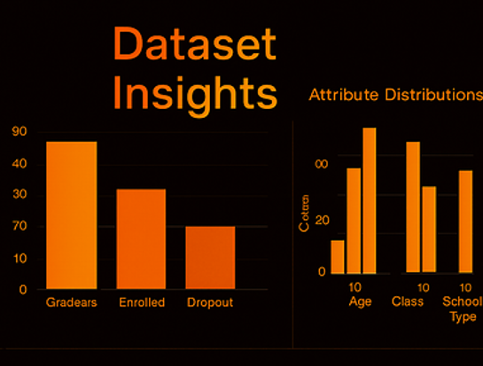
Dataset Insights
Our project utilizes the GitHub Secondary School Student Dropout dataset, chosen for its rich features and real-world relevance to academic retention.
Age
Student's age
Gender
Male/Female
Household
Family income/size
Education
Parental education level
Transport
Commute method
Grade
Academic performance
Dropout Status
Target variable

Slide 7
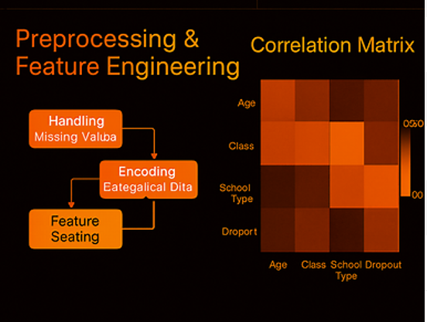
Preprocessing & Feature Engineering
1
Cleaning
Remove duplicates, fill missing values.
2
Encoding
Label Encoding + One-Hot Encoding.
3
Scaling
StandardScaler for feature normalization.
4
Balancing
Stratified train/test split for balanced data.

Slide 8

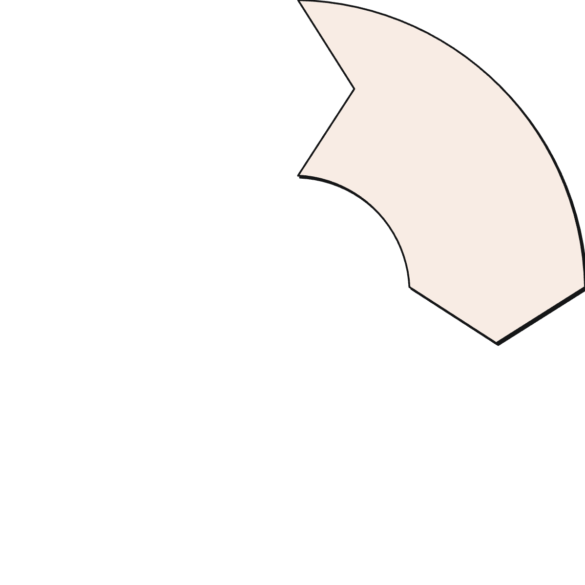




Model Architecture & Selection
Initial Models
Shortlisting
Logistic Regression, RF, NB, DT, KNN, SVM, GB, XGBoost, Voting.
1
Compare performance to shortlist the best 5 models.
2
Final Best
4
Top 3 Selection
XGBoost emerged as the final best model.
Further refine to identify the top 3 performing models.
3

Slide 9
Tech Stack
1
2
Python
Machine learning library
Primary programming language.
Scikit-Learn, Pandas, NumPy, Matplotlib, Seaborn.
3
4
Machine Learning Algorithms
GitHub
Logistic Regression, RF, NB, DT, KNN,SVM, GB,
XGBoost, Voting Classifier
Version control and collaboration.
5
6
Django
Streamlit
Web framework for deployment.
Deployment for web apps.

Slide 10
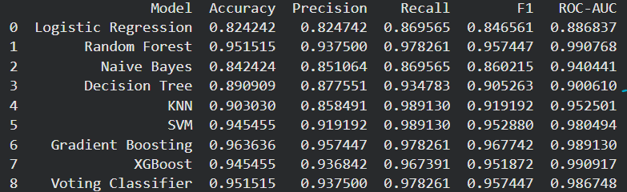
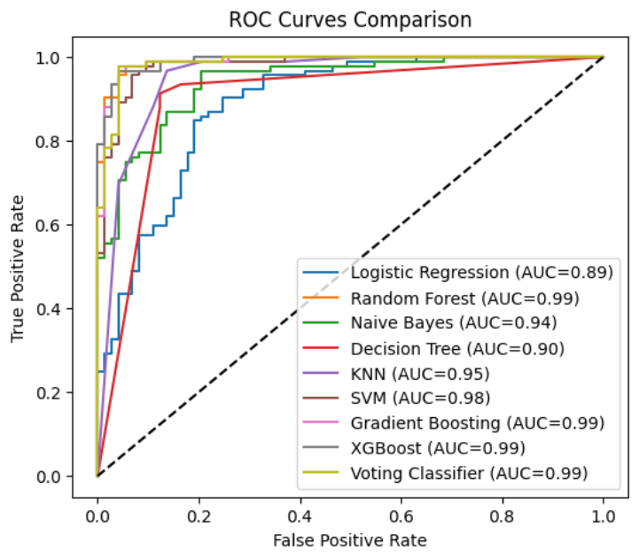
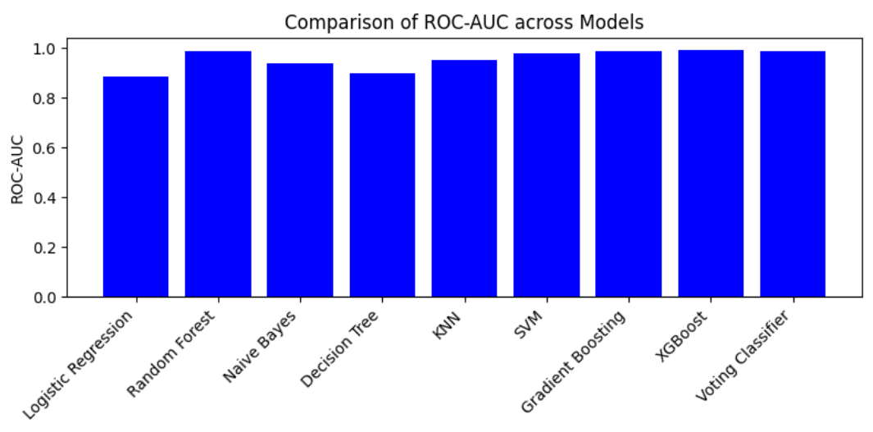
Model Performance & Evaluation Metrics
Our models were rigorously evaluated using key metrics to ensure robust dropout prediction.

Slide 11
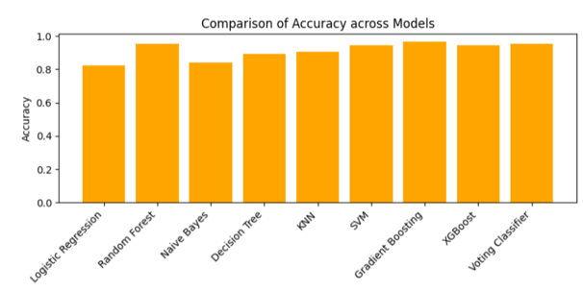
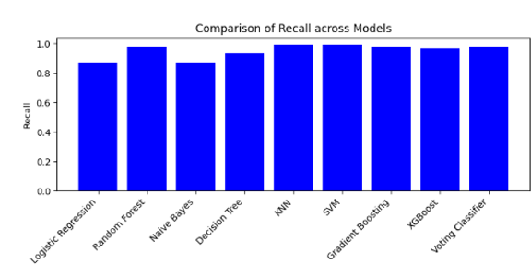
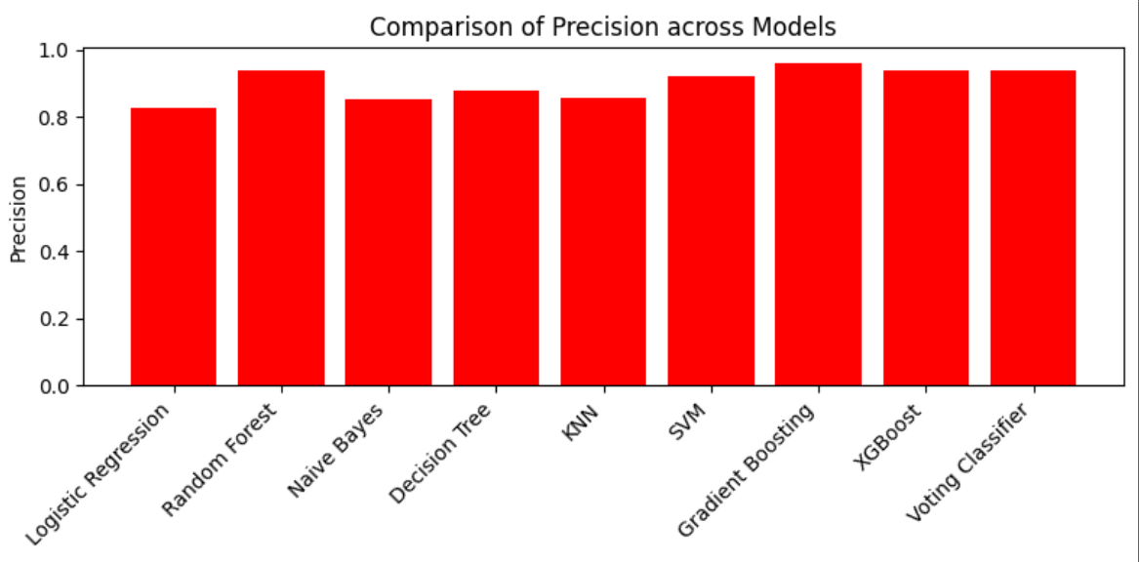
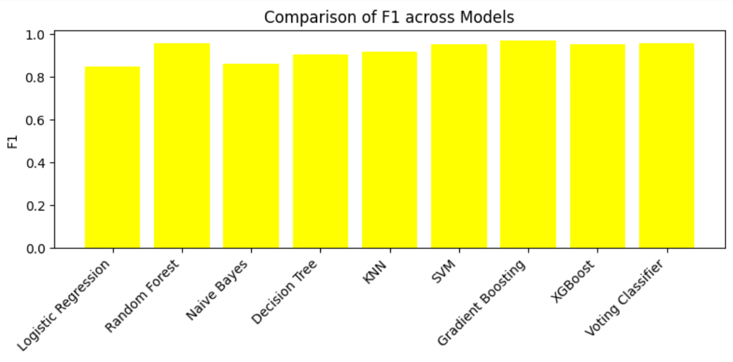
The Random Forest consistently achieved the highest scores across all metrics, demonstrating superior predictive power.

Slide 12
Detection Capabilities
Key Findings
Random Forest emerged as the best-performing model with the highest F1-score and balanced precision-recall value.
Socio-demographic and academic features (e.g., age, class, school type) were strong predictors of dropout risk.
Models like Logistic Regression and Naive Bayes performed reasonably but struggled with recall, missing some at-risk students.
Feature importance analysis highlighted that certain variables (e.g., academic performance, attendance) significantly influence dropout likelihood.

Slide 13
Caveats & Limitations
Solutions
Data Constraints: Limited dataset size and features may restrict generalization across diverse institutions.
Class Imbalance: Dropout cases are fewer, making models biased toward predicting “non-dropout.”
Model Bias: Predictions depend heavily on available features; missing socio-economic or psychological factors reduce accuracy.
Interpretability: Complex models (e.g., ensemble methods) can be harder for educators to understand without explainability tools.
Data Enrichment: Collect broader features (attendance, socio-economic background, parental involvement) to improve prediction.
Imbalance Handling: Use SMOTE, class weighting, or cost-sensitive learning to balance dropout vs non-dropout cases.
Explainable AI: Apply SHAP/LIME to make predictions transparent and actionable for educators.
Deployment: Build dashboards/apps for real-time monitoring and early intervention.

Slide 14
Future Scope
Data Expansion: Include socio-economic, psychological, and behavioral factors (attendance, parental involvement, financial background) for richer predictions.
Advanced Models: Explore deep learning (ANN, LSTM) for sequential/temporal data to capture long-term dropout trends.
Explainability: Integrate SHAP/LIME for transparent predictions, helping educators understand why a student is at risk.
Real-Time Deployment: Build dashboards or apps (StreamLit/Django) for institutions to monitor dropout risk dynamically.
Intervention Strategies: Link predictions with actionable support plans (counseling, scholarships, mentoring).
Cross-Institutional Validation: Test models across multiple schools/universities to ensure generalization and scalability.
Continuous Learning: Implement feedback loops where new student data retrains models, improving accuracy over time.

Slide 15
Conclusion
This project successfully applied machine learning techniques to predict student dropout risk, benchmarking multiple models.
Random Forest emerged as the most effective model, balancing accuracy, precision, and recall while offering feature importance insights.
By combining data-driven predictions with actionable strategies, the project demonstrates how AI/ML can improve student retention and educational outcomes.
With future enhancements in data diversity, explainability, and deployment, this work can evolve into a real-world solution for reducing dropout rates.
The analysis highlights key factors influencing dropout, enabling institutions to design targeted interventions.

Slide 16
References
Student Dropout Prediction Using Machine Learning – IEEE Xplore
Villar, A., & Andrade, C. R. V. (2024). Supervised machine learning algorithms for predicting student dropout and academic success: a comparative study. Discover Artificial Intelligence, Springer,
Predictive Analytics Leveraging a Machine Learning Approach to Student Dropout Rates – MDPI Applied Sciences
Paul, R., Sarker, S., El Aouifi, H., Hussain, S., Baruah, A. K., & Gaftandzhieva, S. (2025). Analysing dropout of students and an explainable prediction of academic performance utilizing artificial intelligence techniques. Frontiers in Education.
Python Libraries and frameworks documentation and GitHub repositories.

Slide 17
Acknowledgement
The team extends its sincere gratitude to Himanshu Khajanchi and Abhey Garg for their dedication, collaborative effort, and consistent contributions throughout the development of this project. Their work in research, analysis, and implementation played a central role in shaping the final outcome.
We also acknowledges the support and involvement of all students of 3rd year, B.Tech CSE, whose feedback, discussions, and encouragement provided valuable insights and helped refine the project. Their collective participation significantly enhanced the quality and direction of the work.
Special appreciation is extended to Geethika Sethi Ma’am for her guidance, encouragement, and academic support, which provided clarity and direction during the course of this work.

Slide 18
THANK YOU
By Group 12

